Slide 1
Learning Objective
I will be able to use derivatives to determine stationary points of a function
Success Criteria
At the end of the lesson, I will be able to:
Determine stationary points of a function

Slide 2
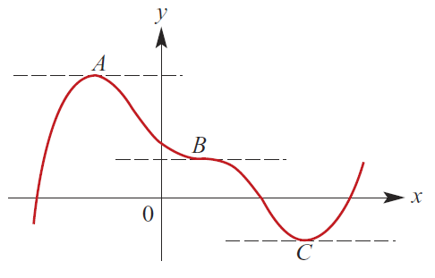
Stationary Point
Concept Development
If at point$x=a{, f}^{′}\left(a\right)=0$, $x=a$ is said to be a stationary point.
There are stationary points at A, B and C.
At such points, the gradient of the tangents are 0.

Slide 3
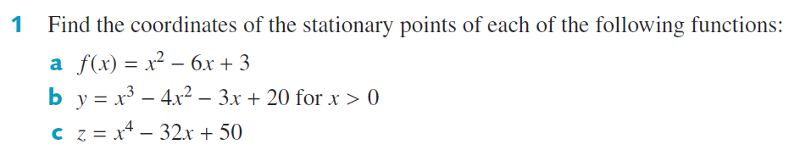
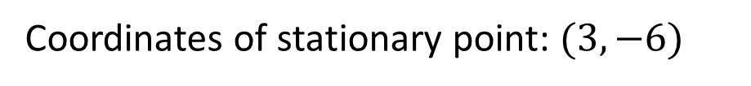

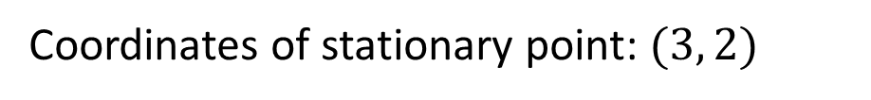



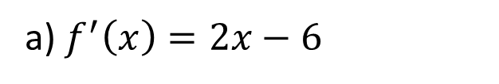

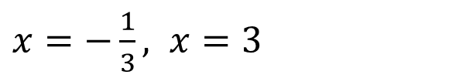







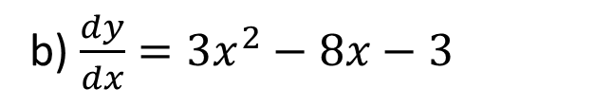
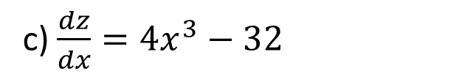
Guided Practice
b) $\frac{dy}{dx}=3x^{2}−8x−3$
a) $f^{′}\left(x\right)=2x−6$
$$2x−6=0$$
$$3x^{2}−8x−3=0$$
$$x=3$$
$$\left(3x+1\right)\left(x−3\right)=0$$
$$f\left(3\right)={\left(3\right)}^{2}−6\left(3\right)+3$$
$x=−\frac{1}{3}, x=3$
$$f\left(3\right)=−6$$
But $x>0, ∴$ only acceptable solution is $x=3$
Coordinates of stationary point: $(3, −6)$
$$y=2$$
$$x=3$$
c) $\frac{dz}{dx}=4x^{3}−32$
Coordinates of stationary point: $(3, 2)$
$$0=4x^{3}−32$$
$$x=2$$
$$z=2$$
Coordinates of stationary point: $(2, 2)$

Slide 4






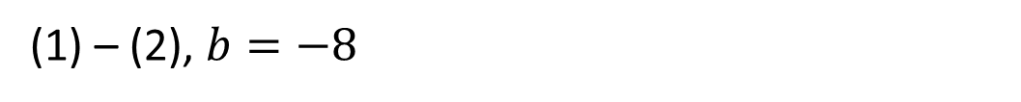

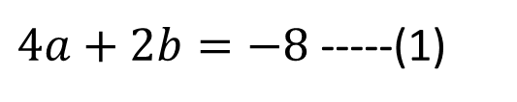


Guided Practice
Substitute (0, -1) into $y$,
$$c=−1$$
(1) – (2), $b=−8$
$$4a−8=0$$
Substitute (2, -9) into $y$,
$$a=2$$
$$−9=4a+2b−1$$
$4a+2b=−8$ -----(1)
$$\frac{dy}{dx}=2ax+b$$
$$2ax+b=0$$
Subst $x=2, 4a+b=0$----(2)

Slide 5
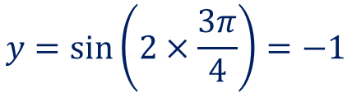



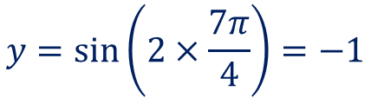


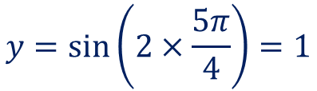

Guided Practice
Determine the stationary points of $y=\sin\left(2x\right), x∈\left[0,2π\right]$
$$\frac{dy}{dx}=2\cos\left(2x\right)$$
Sub. $\frac{dy}{dx}=0, 2\cos\left(2x\right)=0$
$$\cos\left(2x\right)=0, new domain:0≤2x≤4π$$
$$2x=\frac{π}{2},\frac{3π}{2},\frac{5π}{2},\frac{7π}{2}$$
$$x=\frac{π}{4},\frac{3π}{4},\frac{5π}{4},\frac{7π}{4}$$
Sub. Into $y$ to determine y-coordinate
$$y=\sin\left(2×\frac{π}{4}\right)=1$$
$$y=\sin\left(2×\frac{5π}{4}\right)=1$$
$$y=\sin\left(2×\frac{3π}{4}\right)=−1$$
$$y=\sin\left(2×\frac{7π}{4}\right)=−1$$
Stationary points are: $\left(\frac{π}{4},1\right),\left(\frac{3π}{4},−1\right),\left(\frac{5π}{4},1\right),\left(\frac{7π}{4},−1\right)$

Slide 6
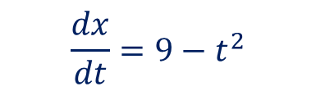
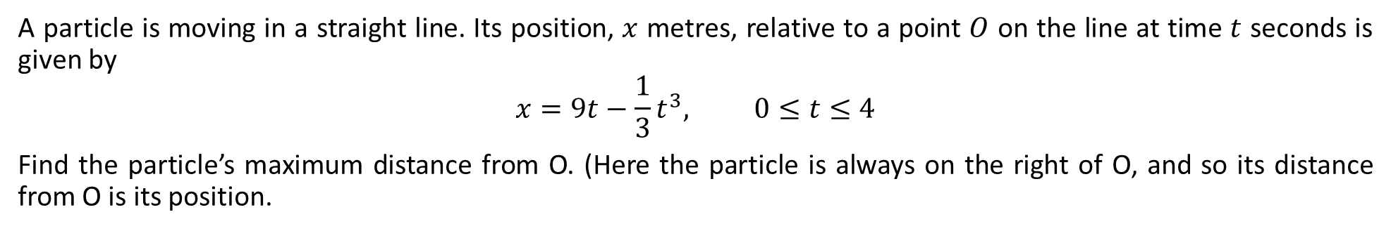
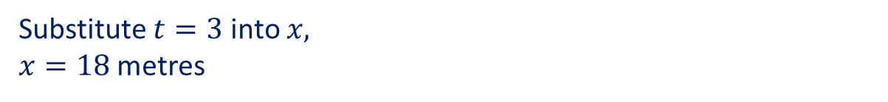

Guided Practice
A particle is moving in a straight line. Its position, $x$ metres, relative to a point $O$ on the line at time $t$ seconds is given by
$$x=9t−\frac{1}{3}t^{3}, 0≤t≤4$$
Find the particle’s maximum distance from O. (Here the particle is always on the right of O, and so its distance from O is its position.
$$\frac{dx}{dt}=9−t^{2}$$
Maximum distance from O occurs when $\frac{dx}{dt}=0$
$$9−t^{2}=0$$
Notice, the stationary point occurs when the velocity is 0. At this moment, the particle is stationary.
$t=3, or t=−3$ (Reject as this lies outside the domain)
Substitute $t=3$ into $x,$
$x=18$ metres
Maximum distance is 18m.
In this exercise, we assume here this will give us the maximum distance. We will typically need to show that this will give us the maximum or minimum. This will be seen in later exercise.

Slide 7

Guided Practice
Determine the $x$ coordinates, in terms of $n$, of the stationary points of the curve with equation $y={\left(2x−1\right)}^{n}(x+2)$ where $n∈ℕ$
$$\frac{dy}{dx}=2n{\left(2x−1\right)}^{n−1}\left(x+2\right)+{\left(2x−1\right)}^{n}$$
Sub. $\frac{dy}{dx}=0, 2n{\left(2x−1\right)}^{n−1}\left(x+2\right)+{\left(2x−1\right)}^{n}=0$
$${\left(2x−1\right)}^{n−1}\left[ 2n\left(x+2\right)+2x−1\right]=0$$
$${\left(2x−1\right)}^{n−1}=0, 2nx+4n+2x−1=0$$
$$x=\frac{1}{2}, x\left(2n+2\right)=1−4n$$
The stationary points are: $x=\frac{1}{2}, x=\frac{1−4n}{2n+2}$

Slide 8
Independent Practice
Complete Cambridge Ex 5D exclude Q2

